Slide 1
Company Review Analysis Sourced from Indeed
Christian Davies
Regis University
https://github.com/chris10davies/MSDS692-Data-Science-Practicum

Slide 2
Summary
Data Mining
Data/Created Variables
EDA
Clean text data/N-grams
Sentiment Analysis
Time Series
Geo Spatial
Unsupervised Learning – Clustering with K-medoids
Topic Modeling with Non Negative Matrix Factorization (NMF) & Latent Dirichlet Allocation (LDA)

Slide 3
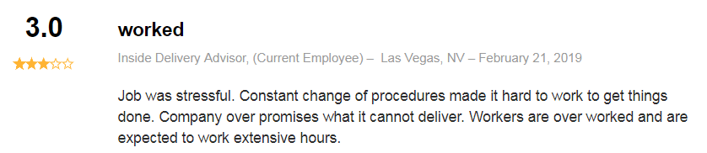
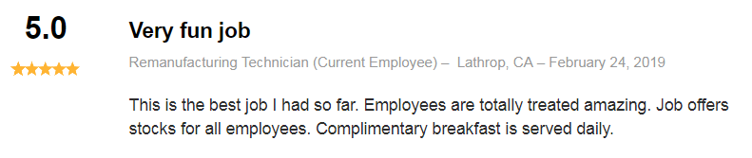
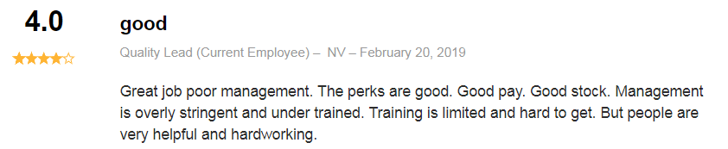
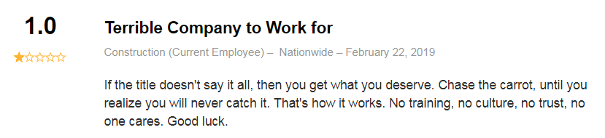
Project Overview
According to a 2018 Monster survey, recruiting is currently harder than it was 5 years ago for 2 reasons:
Good economy
Increase in open jobs
Goal of Project:
Gain insight on what impacts employee satisfaction by analyzing the company reviews from Indeed of 2 companies
Google – known for impressive organizational culture
Tesla – intense, driven culture
Measure results against each companies perceived culture

Slide 4
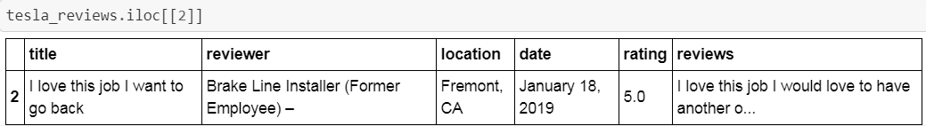
Web-scraping
Urlib.request
(pull data)
Beautiful Soup
(parse data)
Remove Duplicates
(featured review)

Slide 5
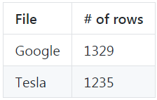
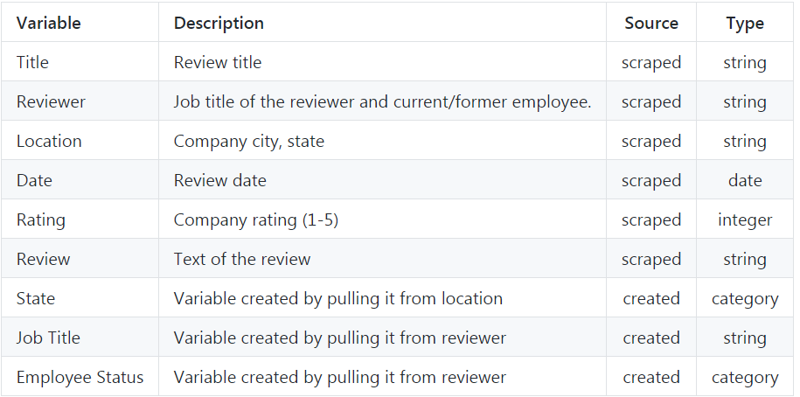


Dataset Information
File Length
2 separate datasets (Google & Tesla)

Slide 6
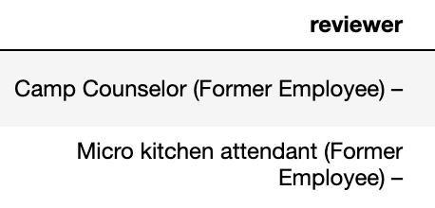
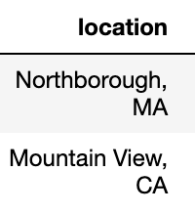
Created Variables
Employee Status/Job Title
State
Split reviewer variable on ‘(‘
Left of ‘(‘ Job Title
Right of ‘(‘ Employee Status
Search Employee Status for ‘Current’
If found, ‘current’
Not found, ‘former’
Split location variable on ‘,‘
Right of ‘,‘ state
Further clean what is capture for state
Keep first 2 characters
Verify against state table, if not found, assign ERR

Slide 7
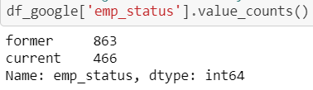
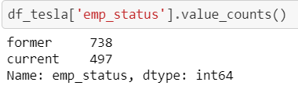
EDA – Employee Status

Slide 8
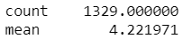
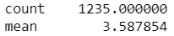
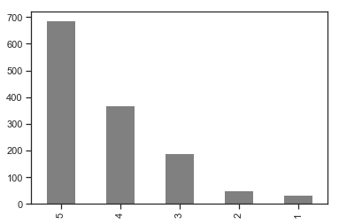
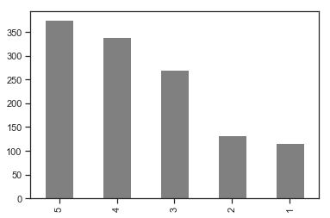
EDA - Rating
Google
Tesla

Slide 9
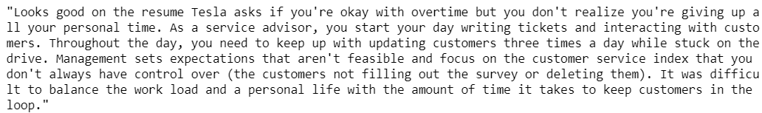
Cleaning Text
Review Text
Remove Punctuation
Replace digits, newlines, multiple spaces with space
Tokenize
Lowercase
Lemmatize
Remove stop words
(added google, tesla, work)
Clean Text)
Text before cleaning:
Text after cleaning:

Slide 10
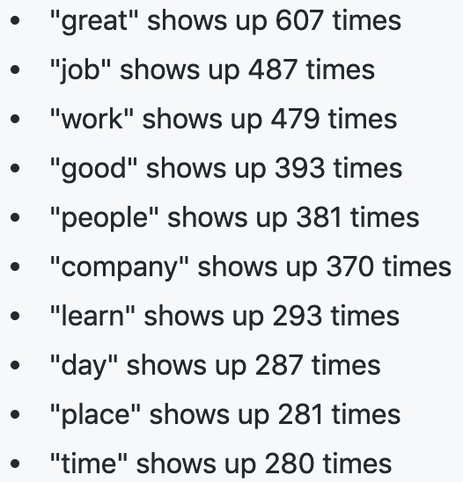
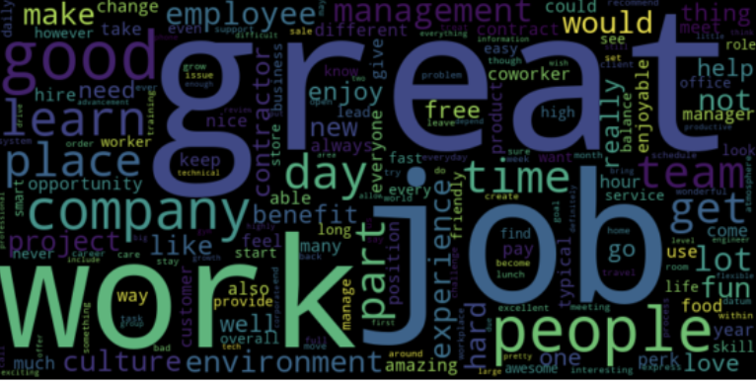
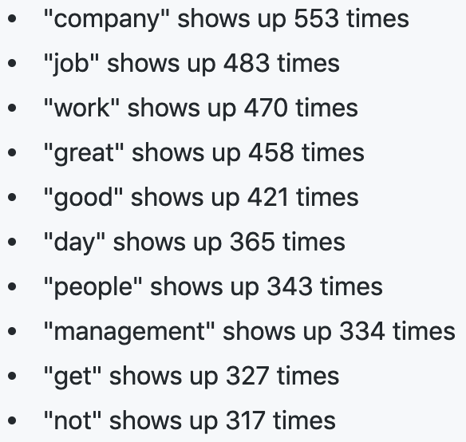
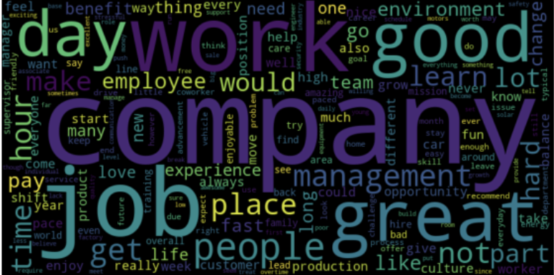
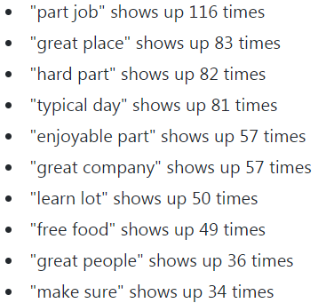
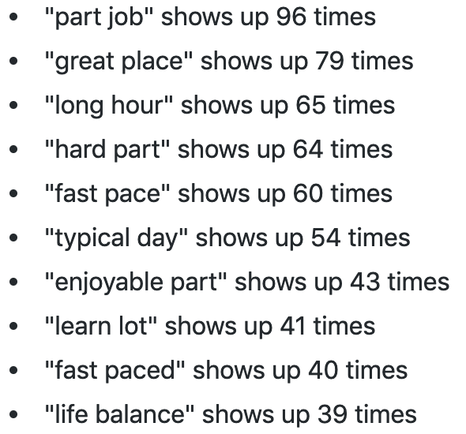
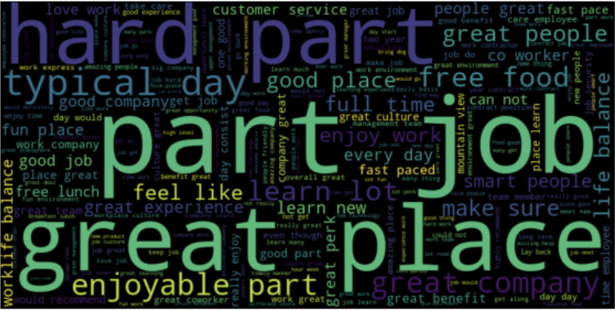
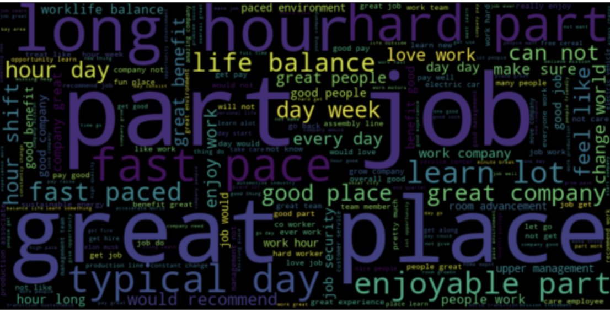
Count Vectorizer Word Counts/Word Clouds
Google 1-Gram
Tesla 1-Gram
Google 2-Gram
Tesla 2-Gram

Slide 11
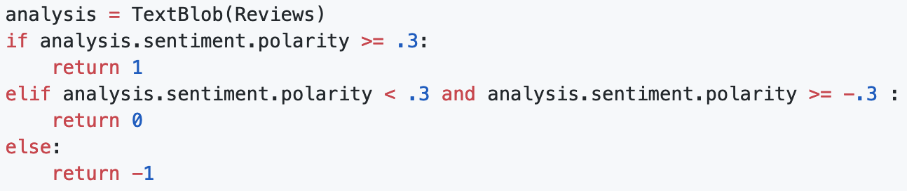
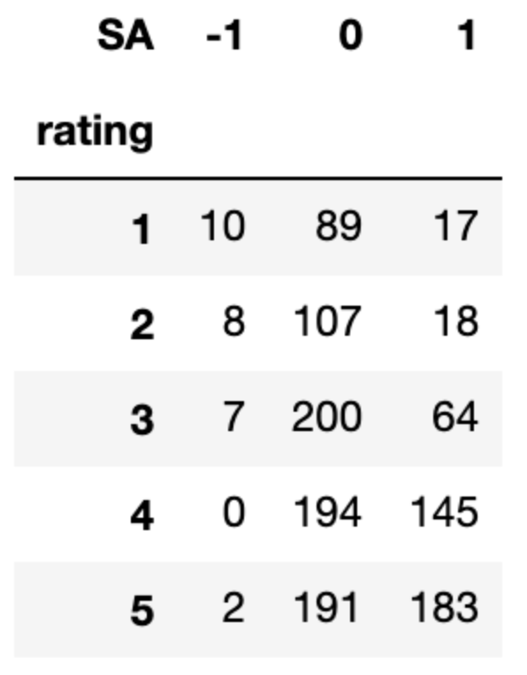
Sentiment Analysis (TextBlob)
Inaccurate sentiment discovered when cross checked assigned sentiment against ratings (e.g. 17 reviews positive sentiment, rating 1)
Adjusting ranges in code did not resolve
Positive Sentiment/Rating 1 Review:
Same as every other tech company now. They will only pay the top people what they want then the rest are left to pick up the pieces. Tesla name carries weight and they know it.
TextBlob Score:
Sentiment(polarity=0.075, subjectivity=0.4, assessments=[(['same'], 0.0, 0.125, None), (['other'], -0.125, 0.375, None), (['only'], 0.0, 1.0, None), (['top'], 0.5, 0.5, None), (['left'], 0.0, 0.0, None)])

Slide 12
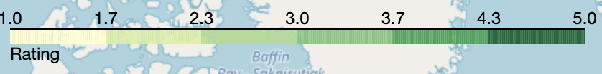
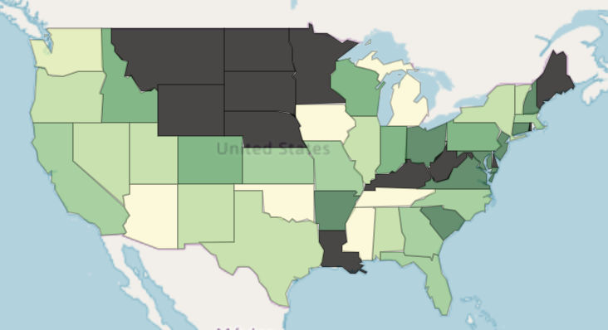
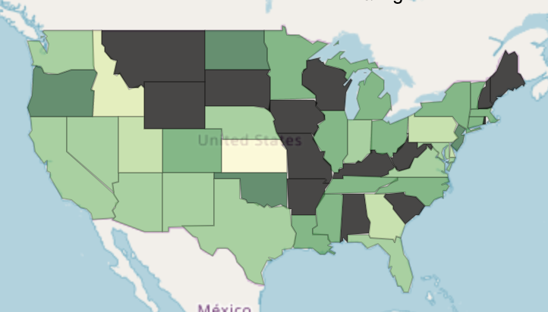


Average Ratings by State
Google
Tesla

Slide 13
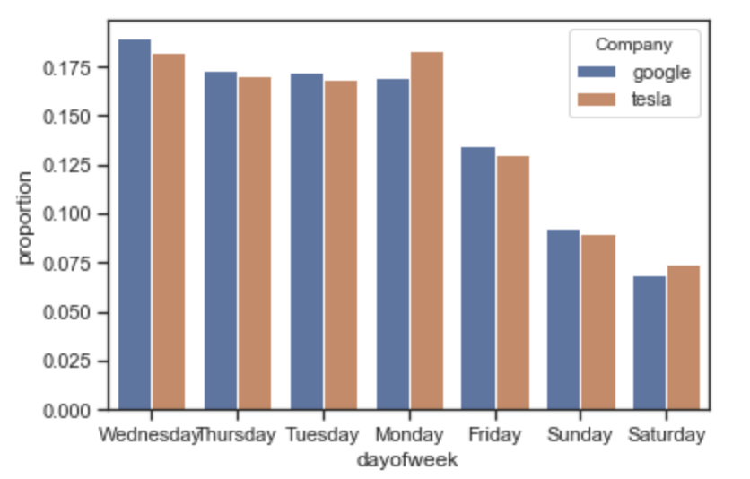
Time Series – Month/Year Review Submitted
Google
Tesla
Smoothed – rolling average
Smoothed – rolling average

Slide 14
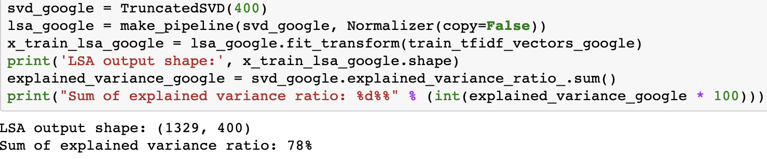
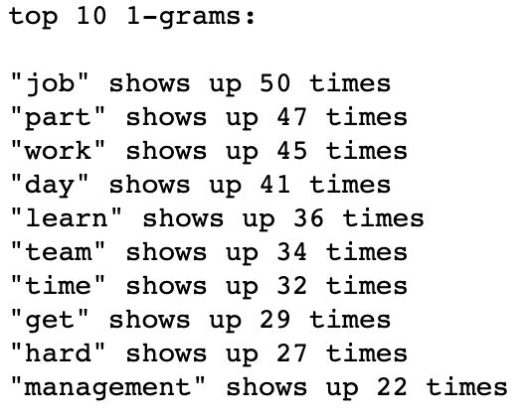
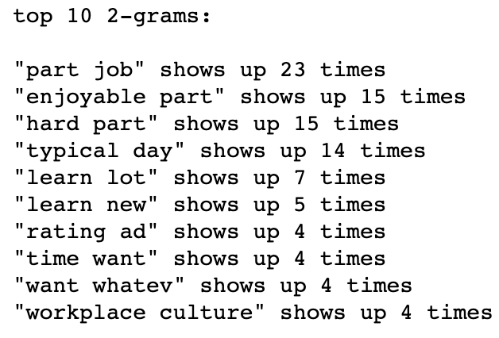
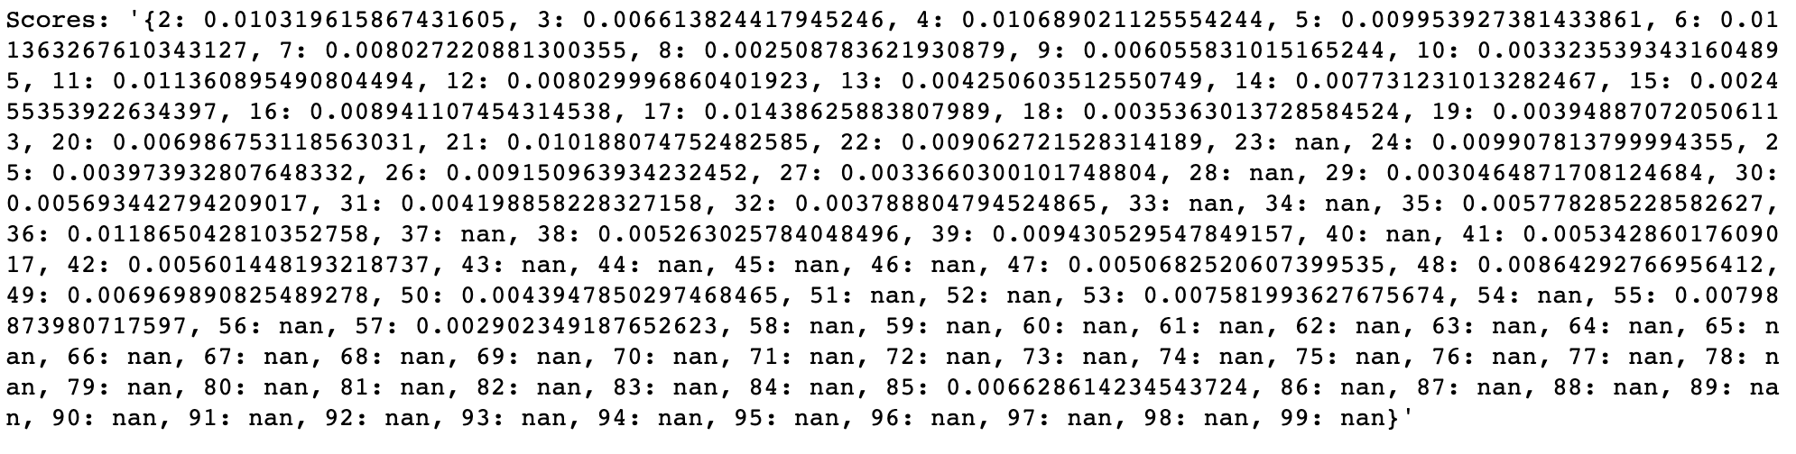
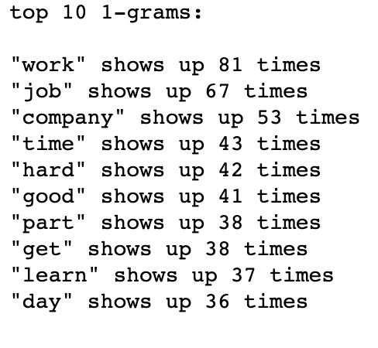
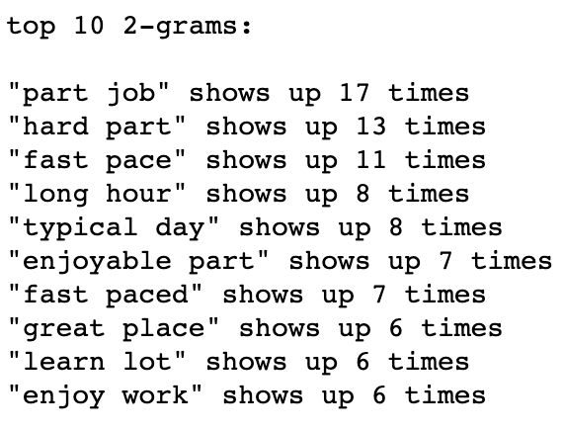
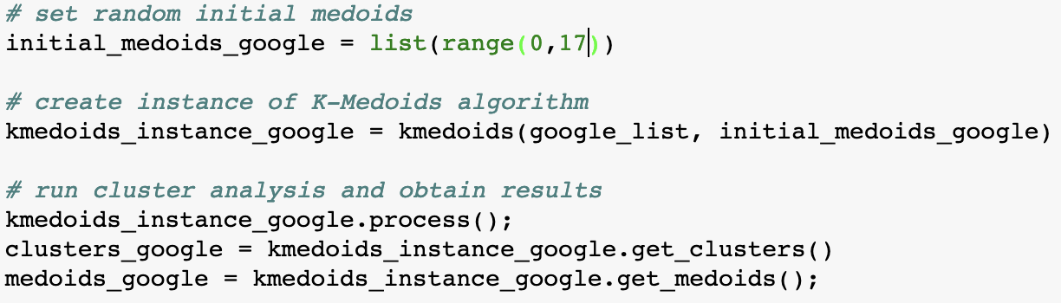
K-Medoids/Clustering
Feature Reduction (LSA)
Cluster with Highest Average TF-IDF – Top Words
Google – Cluster 4
Pyclustering Silhouette
Tesla – Cluster 10
Pyclustering K-Medoids

Slide 15
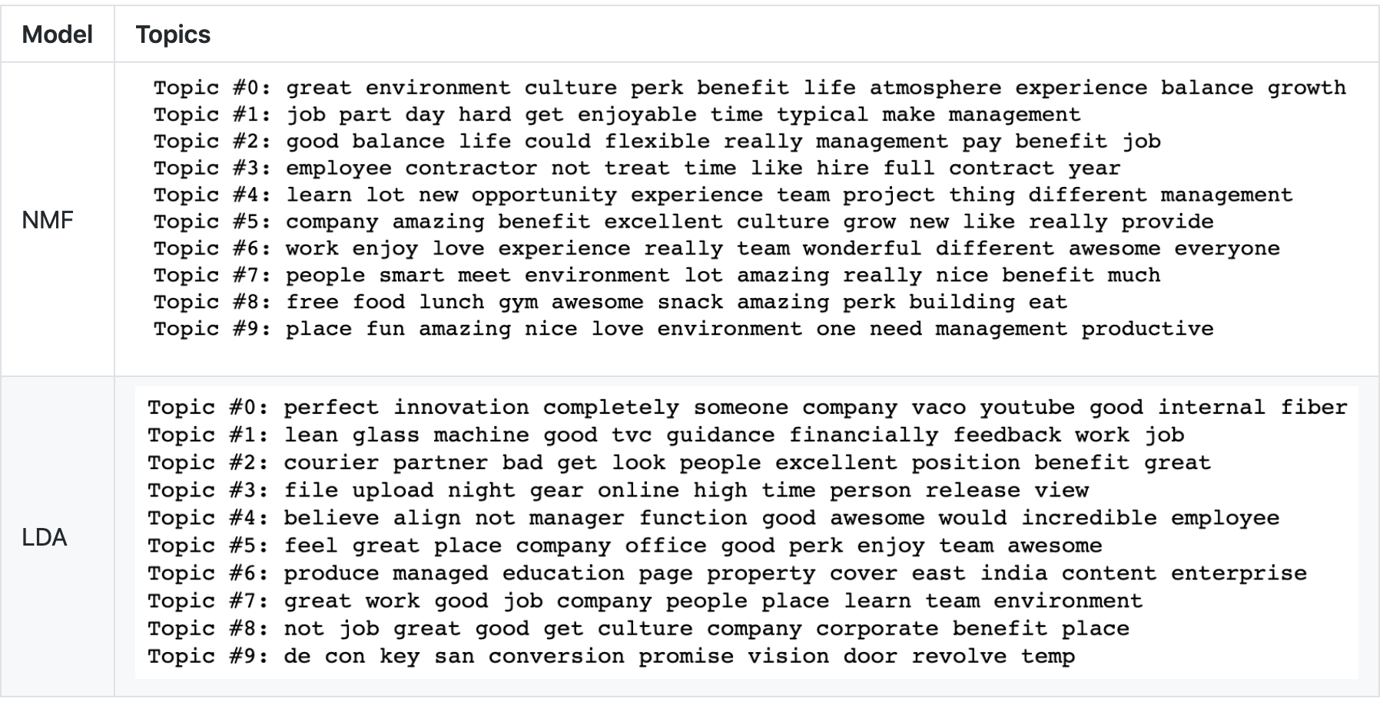
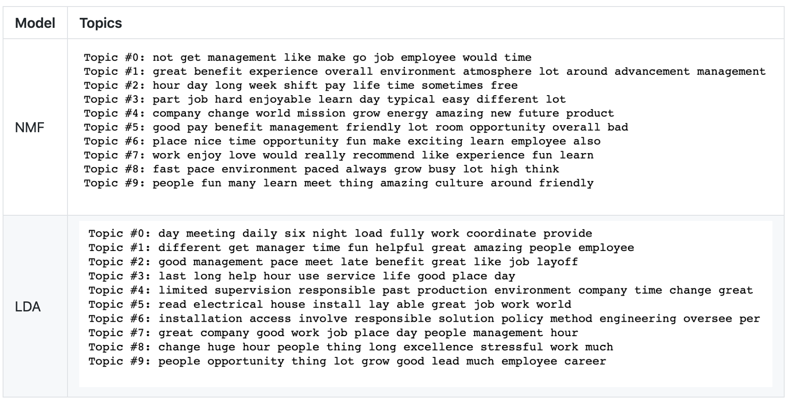
Topic Modeling
Non-negative matrix factorization (NMF) & Latent Dirichlet Allocation (LDA)
Google
Tesla

Slide 16
Conclusions
Analysis matched perceived organizational cultures
Simple Word Counts Impressive
Semantic analysis – Train Classifier
K-Medoids clustering a bit of a struggle – More options in R
Good Results with Topic Modeling
Additional Stop Words

Slide 17
Next Steps
K-Medoids Clustering on Job Descriptions – Group Similar Jobs

Slide 18
Reference
Github - https://github.com/chris10davies/MSDS692-Data-Science-Practicum
George, P. (2018, December 13). Working at Tesla Means Being in an 'Abusive Relationship' With Elon Musk: Report. Retrieved from https://jalopnik.com/working-at-tesla-means-being-in-an-abusive-relationship-1831072258
Schneider, M. (2017, July 26). Google Gets 2 Million Applications a Year. To Have a Shot, Your Resume Must Pass the '6-Second Test'. Retrieved from https://www.inc.com/michael-schneider/its-harder-to-get-into-google-than-harvard.html
Thibodeaux, W. (2018, September 19). 67 Percent of Recruiters Say It's Harder Than Ever to Find Talent. Here's How to Beat the Odds. Retrieved from https://www.inc.com/wanda-thibodeaux/67-percent-of-recruiters-say-its-harder-than-ever-to-find-talent-heres-how-to-beat-odds.html

Slide 19
Thank You

